Slide 1

Chapter 2
SYSTEMS OF LINEAR EQUATIONS
Notes:
Chapter 1 (Linear Algebra):
https://drive.google.com/file/d/1NvARWfnFH7H_gbIhOgxYVhEYr6HjX5hg/view?usp=sharing

Slide 2
Contents
2.1. The rank of a matrix
2.2. Solutions and Elementary Operations
2.3. Gaussian Elimination
2.4. Homogeneous Equations

Slide 3
2.1. The rank of a matrix
The reduced row-echelon form of a matrix A is uniquely determined by A, but the row-echelon form of A is not unique.
The number r of leading 1’s is the same in each of the different row-echelon matrices.
As r depends only on A and not on the row-echelon forms, it is called the rank of the matrix A, and written r = rankA.

Slide 4
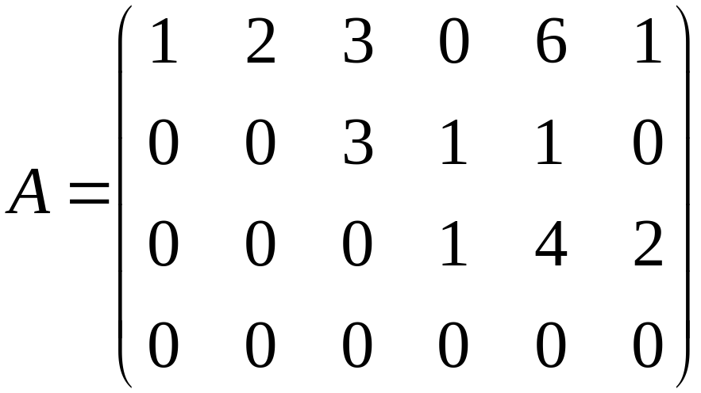
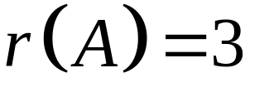
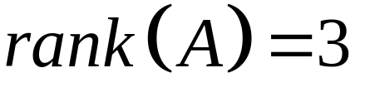
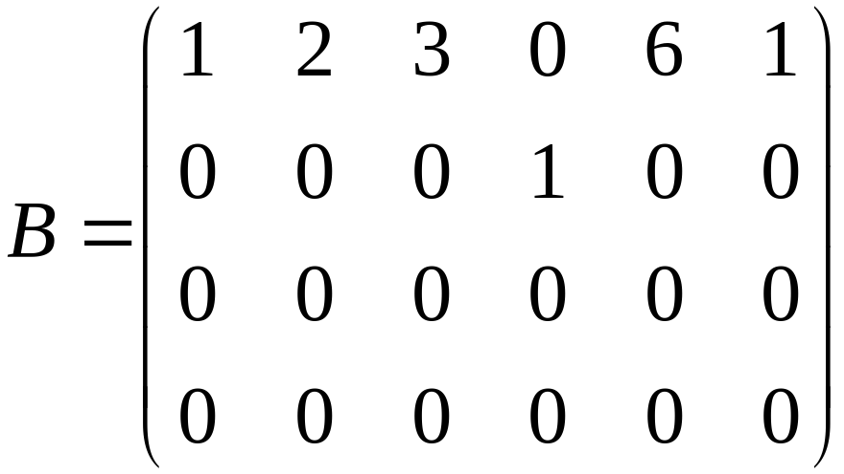
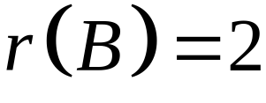
2.1. The rank of a matrix
Example 1:
a/
b/
1
3
1
1
1

Slide 5
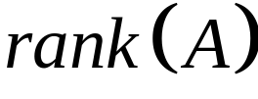
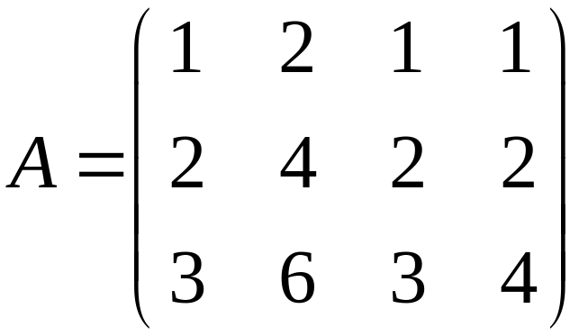
2.1. The rank of a matrix
Example 2: Find

Slide 6
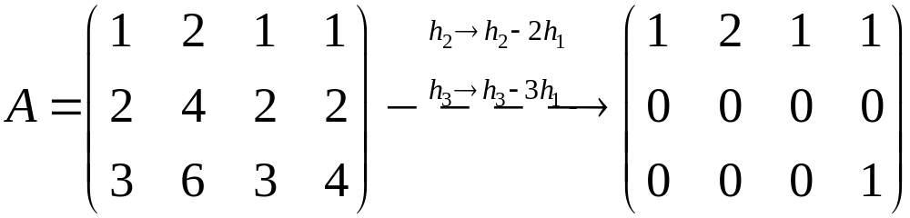
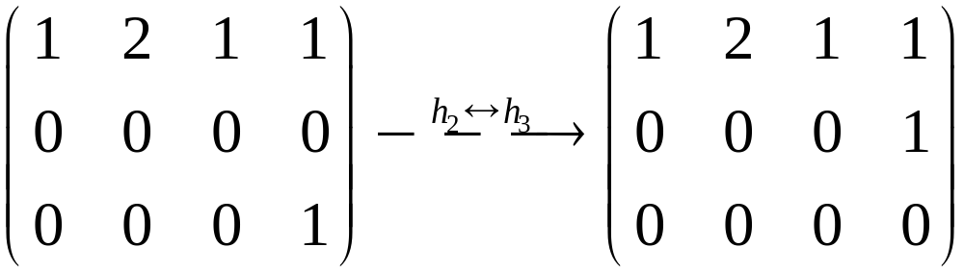
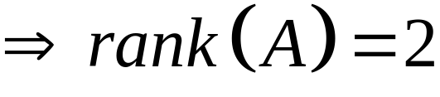
2.1. The rank of a matrix
Solution:

Slide 7
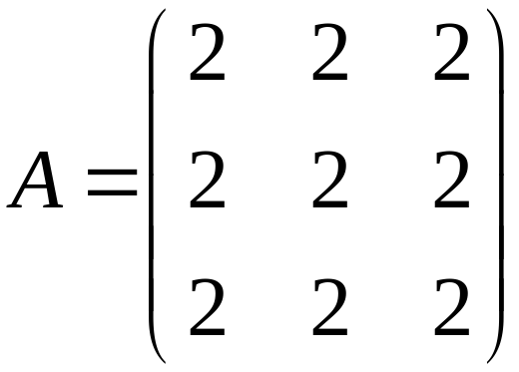
2.1. The rank of a matrix
Example 3: Find

Slide 8
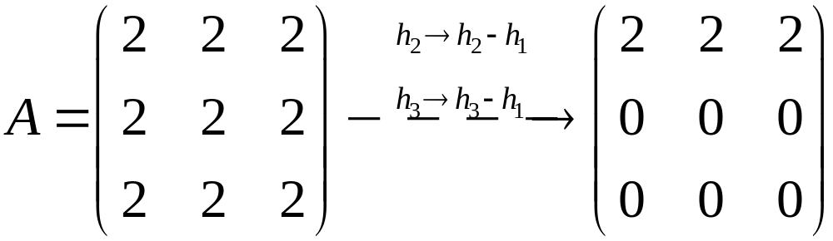
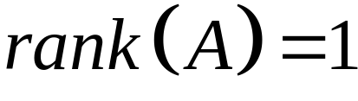
2.1. The rank of a matrix
Example 3: Find
Solution:
So,

Slide 9
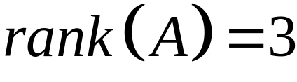

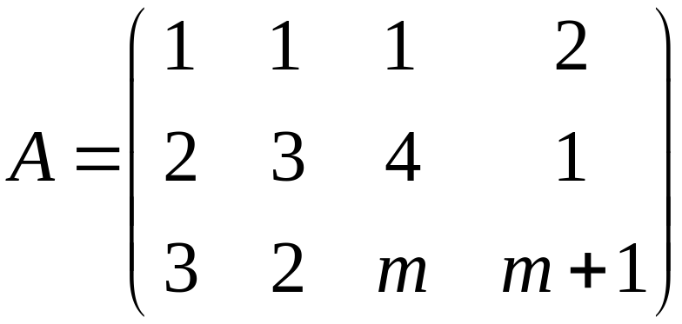
2.1. The rank of a matrix
Example 4:
Find such that

Slide 10
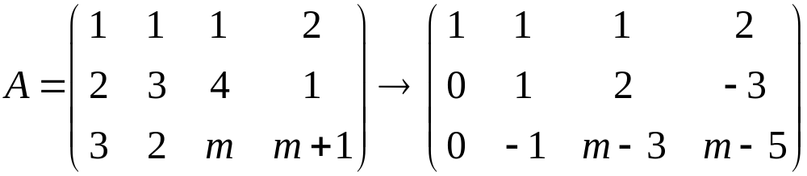
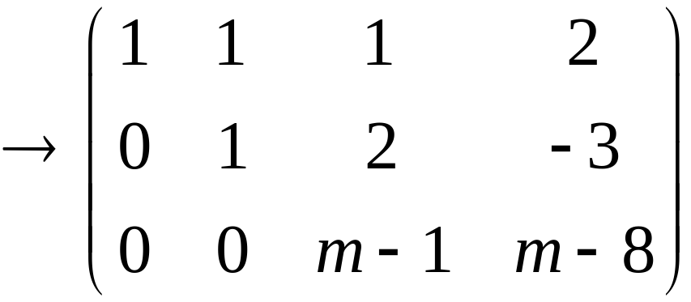
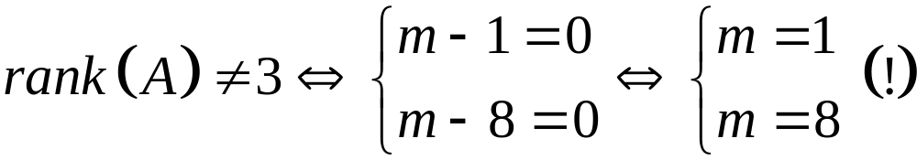
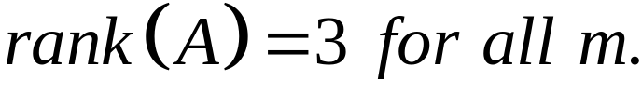
2.1. The rank of a matrix
Solution:
Hence,

Slide 11
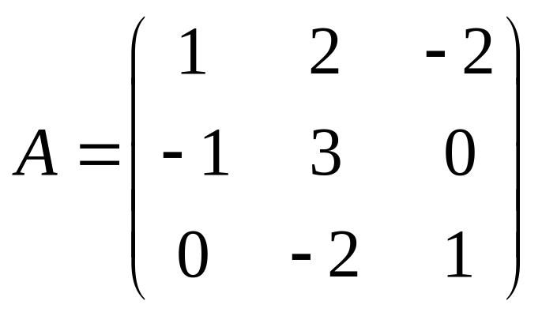
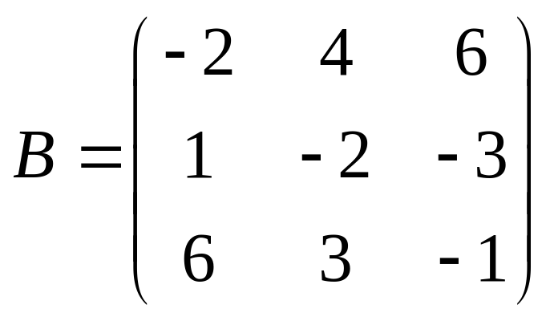
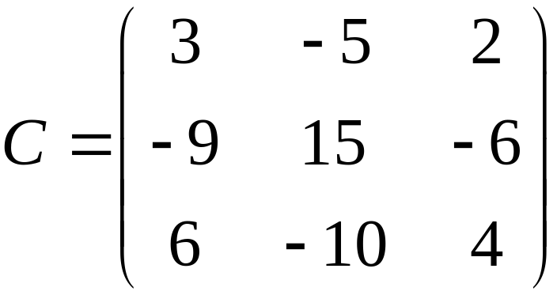
2.1. The rank of a matrix
Example 5: Find the rank of matrices
a/
b/ c/

Slide 12
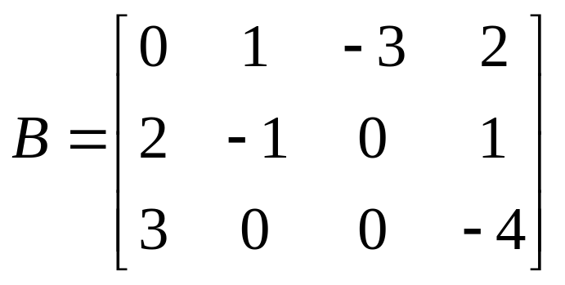
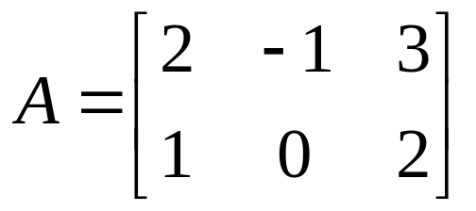
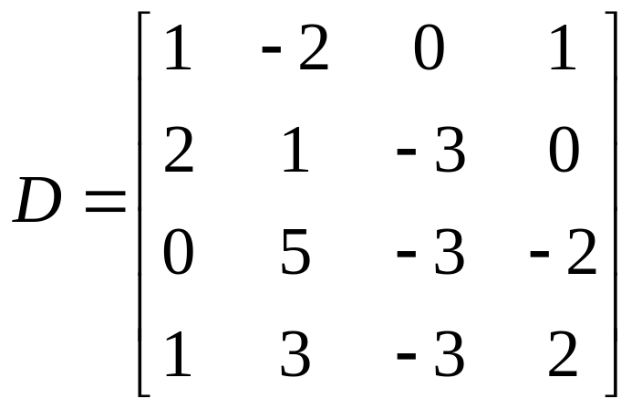
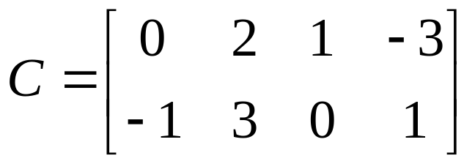
2.1. The rank of a matrix
Example 6: Find the rank of matrices
a/ b/
c/ d/

Slide 13
2.2. Solutions and Elementary Operations
coefficients
variables = unknowns
a₁x₁+a₂x₂+…+a_{n}x_{n}=b is called a linear equation (phương trình tuyến tính)
A solution (nghiệm) to the equation is a sequence s₁,s₂,…,s_{n} such that a₁s₁+a₂s₂+…+a_{n}s_{n}=b
s₁,s₂,…,s_{n} is called a solution to a system of linear equations if s₁,s₂,…,s_{n} is a solution to every equation of the system
A system may have:
no solution
unique solution
an infinite family of solutions

Slide 14
2.2. Solutions and Elementary Operations
A system that has no solution is called inconsistent (không tương thích/ không nhất quán)
A system that has at least one solution is called consistent (tương thích/ nhất quán)
Inconsistent (không tương thích) | Consistent (tương thích)
No solutions ( vô nghiệm) | Unique solution (nghiệm duy nhất) | Infinitely many solutions (vô số nghiệm)

Slide 15
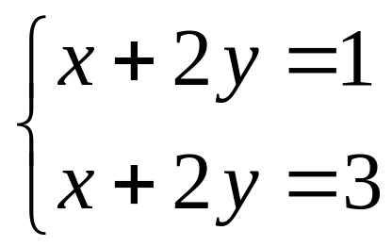
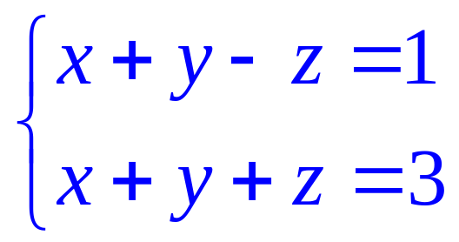
Example:
2.2. Solutions and Elementary Operations
no solution
(0,2,1), (2,0,1)
(t,2-t,1)
Inconsistent
Consistent
(infinitely many solutions)
(t,2-t,1) is called a general solution and given in parametric form, t is parameter ( t is arbitrary)

Slide 16



Elementary Operations (phép biến đổi sơ cấp)
2.2. Solutions and Elementary Operations
Interchange two equations (type I)
Multiply one equation by a nonzero number (type II)
Add a multiple of one equation to a different equation (type III)

Slide 17
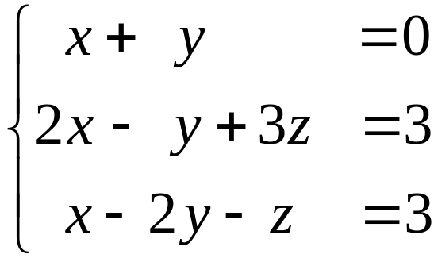
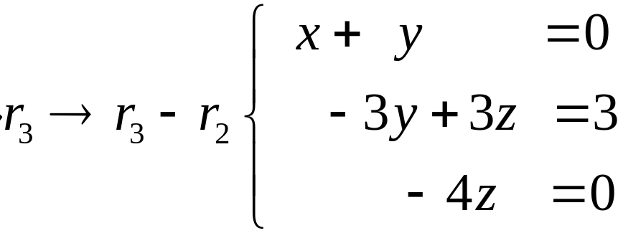
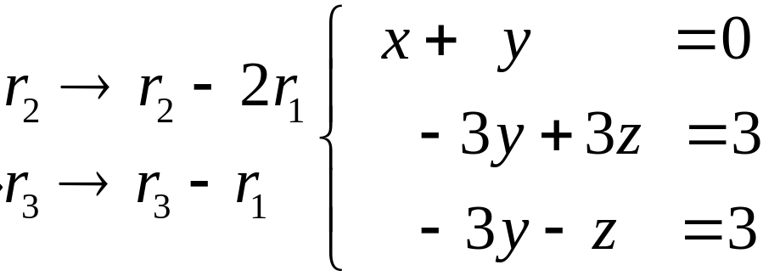
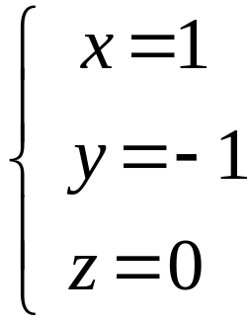
Example 1
1.2. Solutions and Elementary Operations
Find all solutions to the following system
Hence,

Slide 18
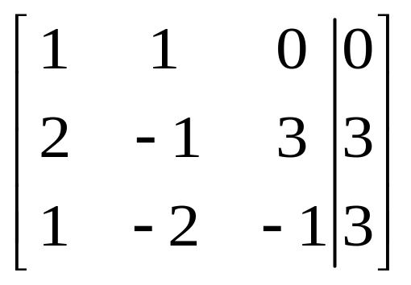
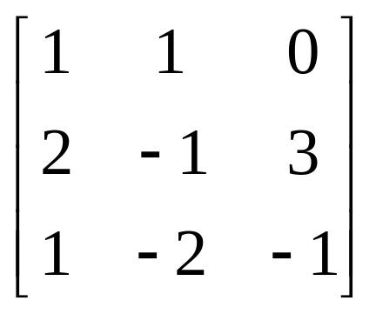
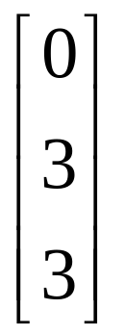
Algebraic Method
2.2. Solutions and Elementary Operations
augmented matrix
coefficient matrix
constant matrix

Slide 19
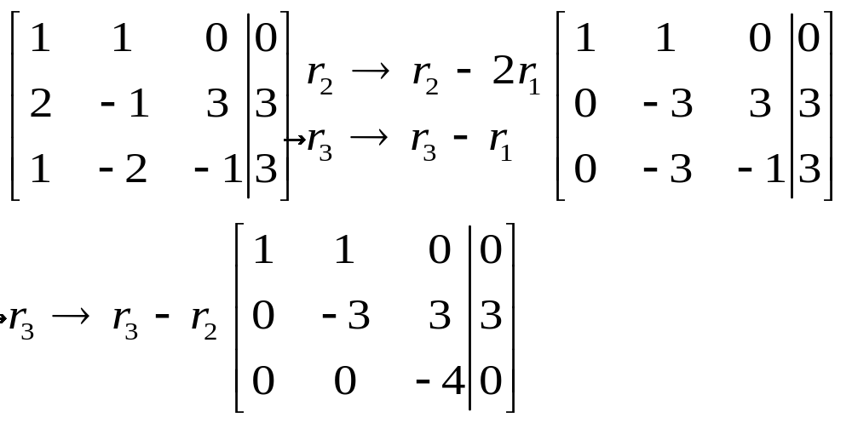
2.2. Solutions and Elementary Operations
Step 1: Find the the row- echelon matrix

Slide 20
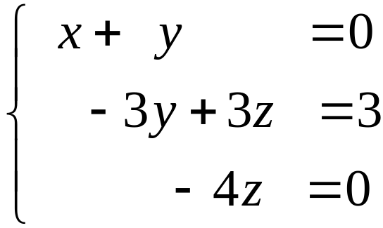
2.2. Solutions and Elementary Operations
Step 2: The following system of equations
is equivalent to the original system.
Step 3: Finally the solutions are given by

Slide 21
2.2. Solutions and Elementary Operations
Theorem
Suppose an elementary operation is performed on a
system of linear equations. Then the resulting system has
the same set of solutions as the original system, so the
two system are equivalent (tương đương).
In this case,their augmented matrices are called row-
equivalent

Slide 22
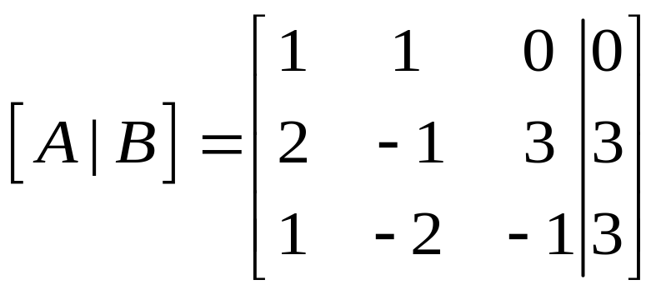
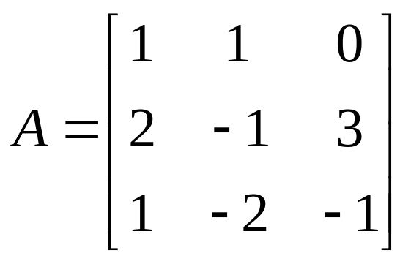
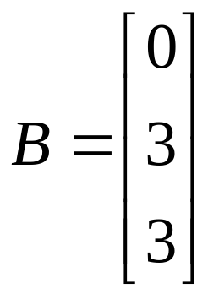
Algebraic Method
2.2. Solutions and Elementary Operations
augmented matrix
coefficient matrix
constant matrix

Slide 23

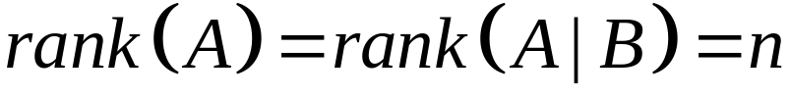
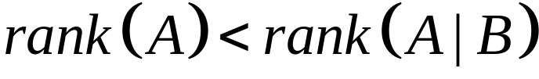
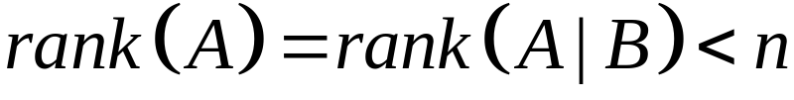

Kronecker–Capelli theorem
2.2. Solutions and Elementary Operations
States that for the non-homogeneous system
i/ has unique solution if and only if
ii/ is inconsistent if and only if
iii/ has infinitely many solutions if and only if
where : is the number of variables of the system of equations .

Slide 24
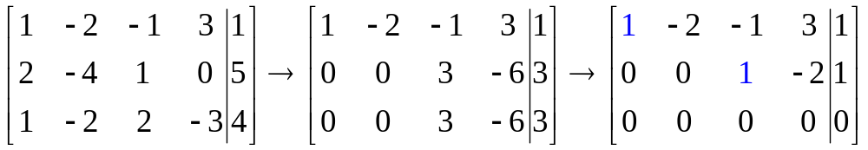
Theorem
2.2. Solutions and Elementary Operations
Suppose a system of m equations in n variables has a
solution. If the rank of the augment matrix is r then the
set of solutions involves exactly n-r parameters.
leading one
rankA=2
4(number of variables)- 2(rankA) =2 (two parameters : x₂=t, x₄=s)

Slide 25

2.3. Gaussian Elimination
Gaussian Algorithm
Step 1: Write the augment matrix.
Step 2: Use the elementary row operations, find row-echelon.
Step 3: Use Kronecker–Capelli theorem
if no solution → stop
if unique solution → solve it.
if infinite solutions
parameters ( nonleading variables ).
Solve the system equations.

Slide 26
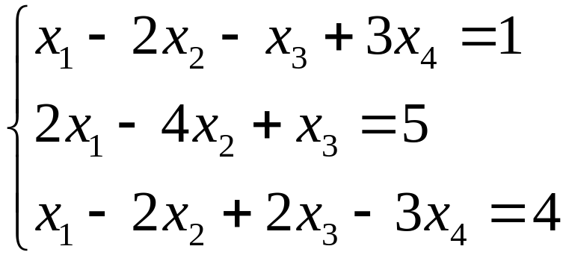
2.3. Gaussian Elimination
Example 2: Solve the following system of equation

Slide 27
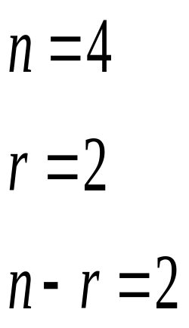
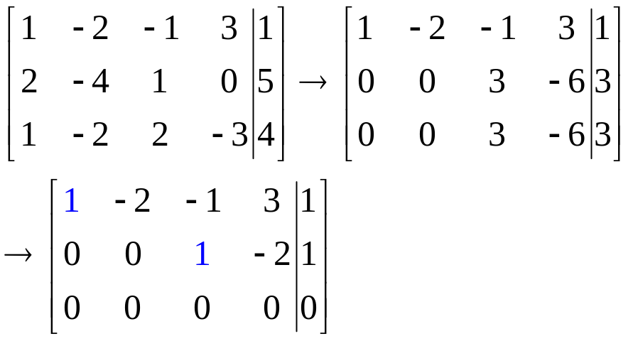
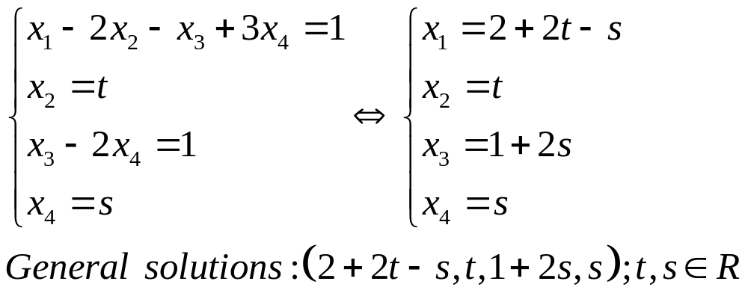
2.3. Gaussian Elimination
Solution:
leading one
reduced row echelon matrix
x₂,x₄ are nonleading variables, so we set
x₂=t and x₄=s (parameters) and then compute x₁, x₃

Slide 28
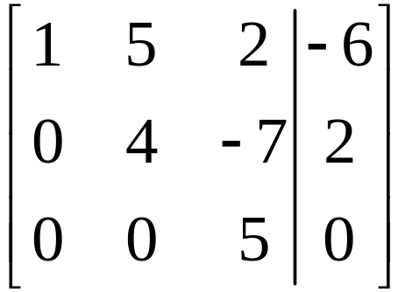
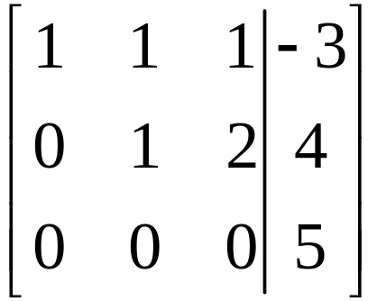


Example 3:
2.3. Gaussian Elimination
Solve the system of linear equation corresponding to the given augmented matrix.
a/ b/
c/ d/

Slide 29



Solution:
2.3. Gaussian Elimination
a/
: unique solution.
The corresponding equations are

Slide 30





Solution:
2.3. Gaussian Elimination
b/
: no solution.
But this last system clearly has no solution (the last equation requires that and satisfy
and no such numbers exist).
Hence the original system has no solution.

Slide 31






Solution:
2.3. Gaussian Elimination
The number of nonleading variables are
c/
: Infinitely many solutions.
The leading ones are in columns 1 and 2 here, so the corresponding variables and are called leading variables.
is nonleading variable, we set , where is arbitrary.
Finally the solutions are given by

Slide 32



Solution:
2.3. Gaussian Elimination
The number of nonleading variables are
d/
: Infinitely many solutions.
The leading ones are in columns 1 and 2 here, so the corresponding variables and are called leading variables.
is nonleading variable, we set , where is arbitrary.
Finally the solutions are given by

Slide 33

2.3. Gaussian Elimination
Example 4:
Solve the following system of equations

Slide 34

2.3. Gaussian Elimination
Solution:
inconsistent

Slide 35

1.3. Gaussian Elimination
Example 5:
Which condition on the numbers a,b,c is the system
consistent ?

Slide 36

2.3. Gaussian Elimination
Solution:
We have
Answer: c-2a+b=0

Slide 37


Example 6:
2.3. Gaussian Elimination
Determine the values of such that the system of linear equations is inconsistent

Slide 38



Solution:
2.3. Gaussian Elimination
We have
The system is inconsistent

Slide 39




Example 7:
Solve the following systems given by augmented matrices
2.3. Gaussian Elimination

Slide 40
2.3. Gaussian Elimination
Example 8: Solve the following system of equation

Slide 41
2.4. Homogeneous Equations
(hệ phương trình thuần nhất)
The system is called homogeneous (thuần nhất) if the constant matrix has all the entry are zeros
Note that every homogeneous system has at least one solution (0,0,…,0), called trivial solution (nghiệm tầm thường)
If a homogeneous system of linear equations has nontrivial solution (nghiệm không tầm thường) then it has infinite family of solutions (vô số nghiệm)

Slide 42

2.4. Homogeneous Equations
Example 1:
Show that the following homogeneous system has nontrivial solutions

Slide 43




2.4. Homogeneous Equations
Solution:
We have
The general solution is
Hence, taking , we get a nontrivial solution

Slide 44

Example 3:
2.4. Homogeneous Equations
Find all values of such that the system
has nontrivial solution

Slide 45



Solution:
2.4. Homogeneous Equations
We have
the system has nontrivial solution

Slide 46

2.4. Homogeneous Equations
Theorem 1
If a homogeneous system of linear equations has more
variables than equations, then it has nontrivial solution
(in fact, infinitely many)
Note that the converse of theorem 1 is not true

Slide 47
System of equations Summary
2.4. Homogeneous Equations
System of | Inconsistent ( no solutions) | Cosistent
 |  | Unique solution (exactly one solution) | Infinitely many solutions
linear equations | yes | yes | yes
linear equations that has more variables than equations | yes | no | yes
homogeneous linear equations | no | yes | yes
homogeneous linear equations that has more variables than equations | no | no | yes

Slide 48



Exercises 1
2.4. Homogeneous Equations
1 Find all a,b such that the matrix is an reduced row-echelon matrix.
◻ a=b=1
◻ a=0 and b=1
◻ a=b=0
☑ a=1 and b=0
◻ None of the others

Slide 49


Exercises 2
2.4. Homogeneous Equations
Find all values of m such that the system has no solution, (another word: inconsistent)
Answer:
Carry the augmented matrix to row-echelon form
The system has no solution iff m≠7

Slide 50
Exercises 3
2.4. Homogeneous Equations
Choose the correct statements.
☑ If the system has trivial solution, then it is a homogeneuos system
◻ A homogeneous system of 7 equations and 5 variables always has many solutions
☑ A consistent system of 12 equations and 15 unknowns must have infinitely many solutions
☑ If a homogeneous system has an nontrivial solution, then it has infinitely many solutions
Homogeneous + more variables than equations  many solutions (vsn),
chắc chắn có nghiệm không tầm thường
Homogeneous + exist nontrivial solution  infinitely many solutions (vsn)

Slide 51
Exercises 4
2.4. Homogeneous Equations
Consider a system of 203 linear equations in 133 variables. Choose
the correct statements.
☑ If the system is homogeneous there is always at least one solution
☑ There may be infinitely many solutions.
◻ There may be exactly three solutions.
◻ If the system is homogeneous there are always infinitely many solutions.
☑ There may be exactly one solution.
◻ There is always at least one solution.
☑ There may be no solution
Homogeneous  consistent (luôn có ít nhất một nghiệm)

Slide 52


2.4. Homogeneous Equations
Exercises 5
Find the rank of the matrix
◻ 1
☑ 2
◻ 3
◻ 4
◻ 3x3
rankA = the number of leading ones in the row echelon form of A

Slide 53


Exercises 6
2.4. Homogeneous Equations
Find all values of m such that the matrix has the rank 2.
Solution:
Carry the augmented matrix to row-echelon form
rankA=2 iff m=5 (rankA=3 iff m ≠5)
rankA=the number of leading ones in the row echelon form of A

Slide 54

2.4. Homogeneous Equations
Exercises 7 : Given a homogeneous system of 23 unkowns (n=23) and 35 equations. Suppose the augmentad matrix of the system has the rank 17 (r=17). How many parameters in the solution of the system?
◻ 17
◻ 23
◻ 12
☑ 6
◻ None of the others
x₁ x₂ x₃ x₄
Number of parameters = number of nonleading variables
= n - r (số ẩn – hạng ma trận)
r = rankA = number of leading ones
leading variables: x₁, x₃
nonleading variables: x₂, x₄

Slide 55


2.4. Homogeneous Equations
Exercises 8: Solve the homogeneous system
Carry the augmented matrix to (reduced) row-echelon form
Solution: w=t, z=4t, y=3t, x=3t
w is nonleading variable, so w=parameter=t

Slide 56


Exercises 9:
2.4. Homogeneous Equations
◻ m=1
☑ m=±2
◻ m=0
◻ m= ± 1
◻ m=3

Slide 57


Exercises 10:
2.4. Homogeneous Equations
◻ m≠1
☑ m = -1
◻ m=1
◻ m= ± 1
◻ m ≠-1

